Slide 1
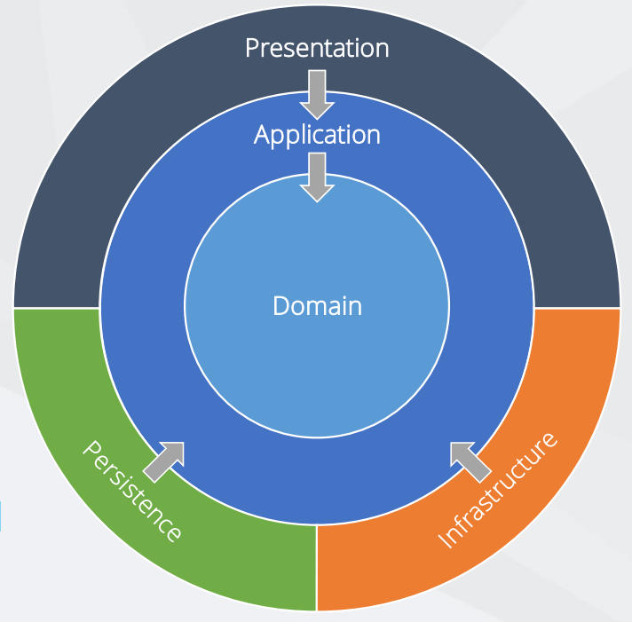
.NET 6 Clean Architecture
Domain
The domain is the base and heart of this architecture.
It basically consists of Domain models or Entities and its corresponding Entity configurations.
This domain layer consists of repositories to deal with operations with databases. We can use the domain-driven design to design the domain project.
Application Layer
which contains all the business logic from the outer layers and it only depends on the domain layer. It generally consists of DTO models, interfaces and command, query handlers, and Validators.
Persistence Layer
This is also called Data Access Layer, in this layer we can define dbContext, migrations, configurations, data seeding and abstractions.
This is also depends on the Application layer.

Slide 2
.NET 6 Clean Architecture
Technologies
Features
.NET Core 6 WebAPI Project
Visual Studio 2022
MS SQL Server 2019
Repository Pattern – Generic
MediatR Pipeline Logging & Validation
Serilog
Swagger UI
Response Wrappers
Pagination
JWT Authentication
Role based Authorization
Identity Seeding
Database Seeding
Custom Exception Handling Middlewares
API Versioning
Fluent Validation
Automapper
SMTP / Mailkit / Sendgrid Email Service
Complete User Management Module (Register / Generate Token / Forgot Password / Confirmation Mail)
User Auditing
Table of Contents
Implementing Clean Architecture in .NET Core WebApi Project:
Setting up the Solution Structure
Adding The Entities to the Domain Project
Adding the Required Interfaces And Packages in Application Layer
Implementing MediatR for CRUD Operations (CQRS pattern)
Setting Up EF Core on the Persistence Project
Generate the Migrations and the Database using code first approach

Slide 3
.NET 6 Clean Architecture
Infrastructure Layer
This layer consists of any kind of logic which needs to be communicated with 3rd party API like Email / SMS and external systems also the Implementations of interfaces which defined in application layer. This layer depends only on the Application Layer.
Presentation Layer
Presentation Layer is generally the UI part of the system, which we can define Web API, Razor pages, MVC, Angular, React, Web Forms etc.
This also depends only on the Application layer.
Benefits:
Any changes in UI will not affect to other layers as they are loosely coupled.
Implementation of any new features will be relatively easy which reduces the complexity of the solutions.
Debugging and error fixing becomes easier for developer
It will be easier to understand the code whenever a new developer starts working on this code.
All the layers of the system are loosely coupled and change in one layer should not break the other layer.

Slide 4
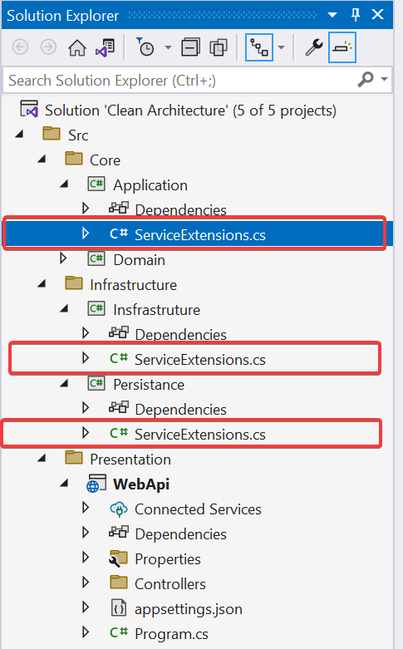
Service Extensions Method in .NET 6 Clean Architecture
1-Add Project references
2-Install NuGet package: Microsoft.Extentions.DependencyInjection.Abstractions
3-Service Extension Method

Slide 5
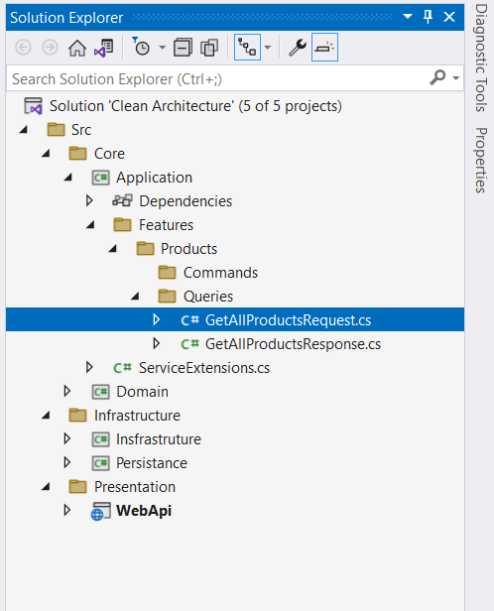
CQRS Pattern with MediatR in .NET 6 Clean Architecture
1-Implementing MediatR with (CQRS Pattern) for CRUD Operations in application project
- Install-Package MediatR
In the Application Layer, Create a New Folder called Features. This will have all the logic related to each Feature / Entity. Under this folder, add a new one and name it Products. Then add a Commands and Queries folder to it.
Adding BaseApiController in WebApi, then add Product Controller in WebApi project

Slide 6
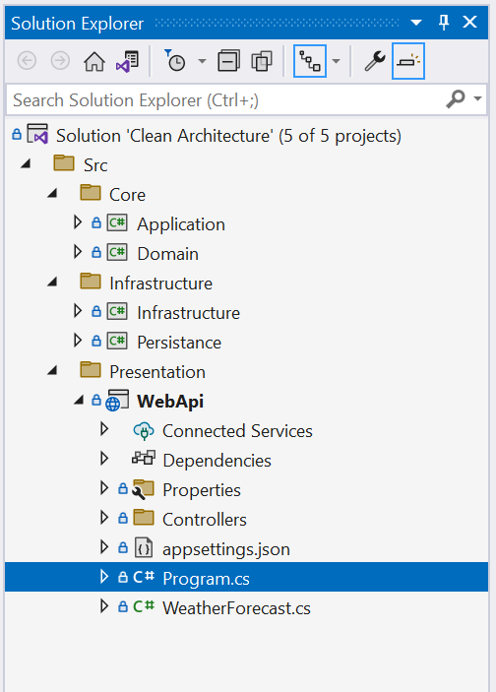
Entity Framework in .NET 6 Clean Architecture
STEPS:-
Add model classes in Domain
1-Common > BaseEntity.cs
2-Entites > Product.cs
Install these package inthe Persistance
1-Microsoft.EntityFrameworkCore
2-Microsoft.EntityFrameworkCore.SqlServer
Install these package into WebApi
1-Microsoft.EntityFrameworkCore.Tools
2-Microsoft.EntityFrameworkCore.Design
1-Add Context folder in Persistence
2-Add ApplicationDbContext class in the Context
3-Add Connection string
4-Run Migrations

Slide 7
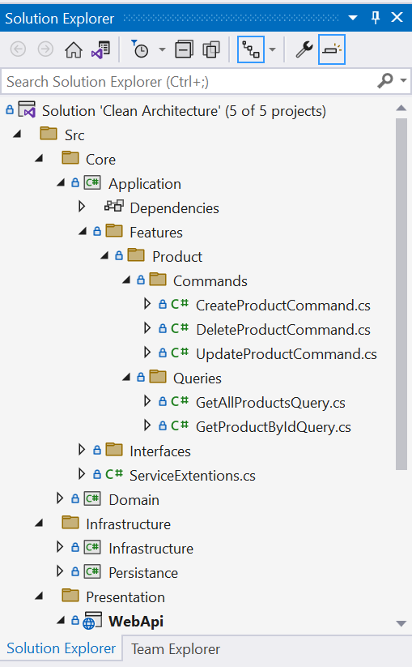
CRUD Operations with CQRS and Entity Framework in .NET Clean Architecture
STEPS:-
Create an Interface of ApplicationDbContext
Create a folder in Application layer as Interfaces here we put all the interfaces and use in whole project.
Register Interface with ApplicationDbContext

Slide 8
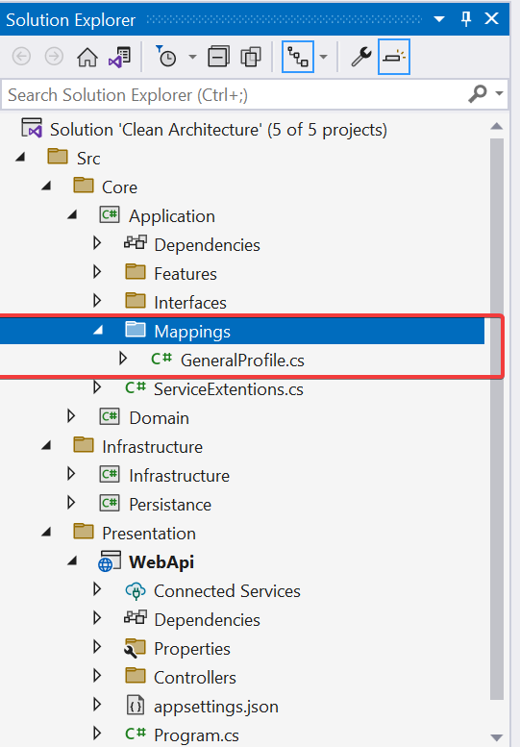
Automapper in .NET Core Clean Architecture
STEPS:-
What is Automapper?
AutoMapper is the most common library used to map one object to another, you can transmit the data in your input object to an output object, It certainly makes a developer’s life easy.
The biggest benefit of using AutoMapper in your project is a cleaner code, requiring fewer lines to transmit data between different objects. This cleaner code will also reflect in a shorter development time, requiring less time and code to map objects.
--------------------------------------------------------------------------
Installing the Automapper Package
- AutoMapper.Extensions.Microsoft.DependencyInjection
- AutoMapper
- Configuring the Service
- Creating a Mapping Profile
- Mapping Properties with Different Names
- Reverse Mapping using Automapper

Slide 9
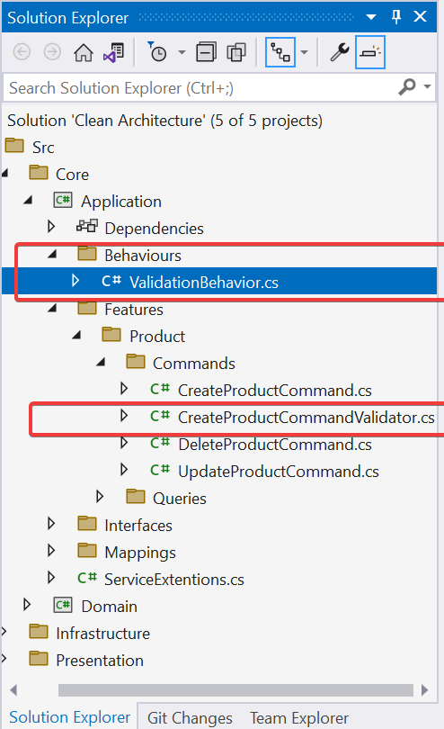
FluentValidation with Pipeline Behaviors in .NET Core Clean Architecture
FluentValidation is a popular .NET library for implementing validation rules in your application. It provides a fluent API for defining validation rules for your models.
Install-Package FluentValidation.AspNetCore
Install-Package FluentValidation.DependencyInjection
PipelineBehavior is a feature in .NET Core that allows you to intercept and manipulate requests and responses in a pipeline. You can use FluentValidation in combination with PipelineBehavior to perform validation on incoming requests and handle validation errors in a centralized way.

Slide 10
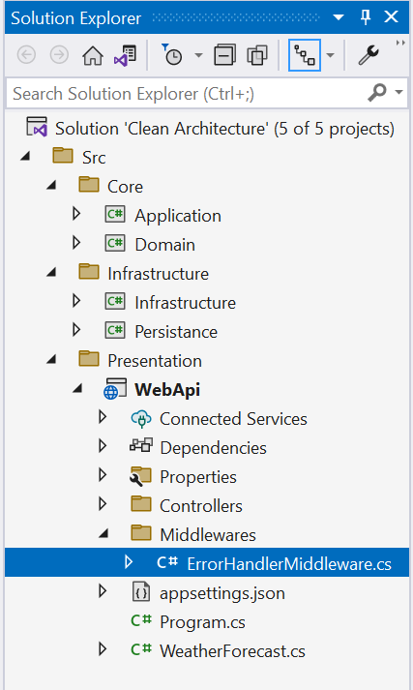
Generic Exception Handling in .NET Core Clean Architecture
- Custom Exception Middleware: We will define Custom Exception Middleware class to handle any type of Exceptions.
In this section, we demonstrate how to create a typical custom middleware class. Custom middleware also provides much more flexibility to handle exceptions. We can add a stack trace, an exception type name, error code, or anything else which we want to include as a part of the error message.
- What is Middleware : Middleware executed on every request. These components are responsible for handling various tasks such as request routing, authentication, logging, and more.
- Well Format Api Response: Create a new class in Wrappers folder name as ApiResponse and define the properties in ApiResponse.

Slide 11
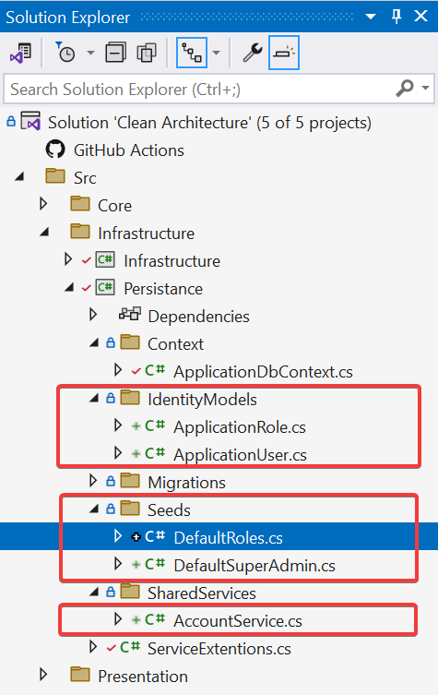
Identity in .NET Core Clean Architecture in Hindi Urdu
- What is asp.net core identity: It is built-in membership system.
It allows us to add features where users can register and log in with password, also user can create, read, update, delete user accounts.
This is also supports two-factor authentication, Account Confirmation, third-party identity providers like facebook, google and other features. But in this video we will focus on user register , login and logout.
- Before implement identity you need to install these packages:
Microsoft.AspNetCore.Identity.EntityFrameworkCore
Microsoft.EntityFrameworkCore.SqlServer
Microsoft.EntityFrameworkCore.Design
- UserManager<IdentityUser>: We will use this built-in class to create/register, update, delete user, this class contains these methods
CreateAsync
UpdateAsync
DaleteAsync
CheckPasswordAsync, Etc...
- RoleManager<IdentityRole>: We will use this built-in class to create and seed default roles, this class contains these methods:
CreateAsync
UpdateAsync
DeleteAsync
Etc…

Slide 12
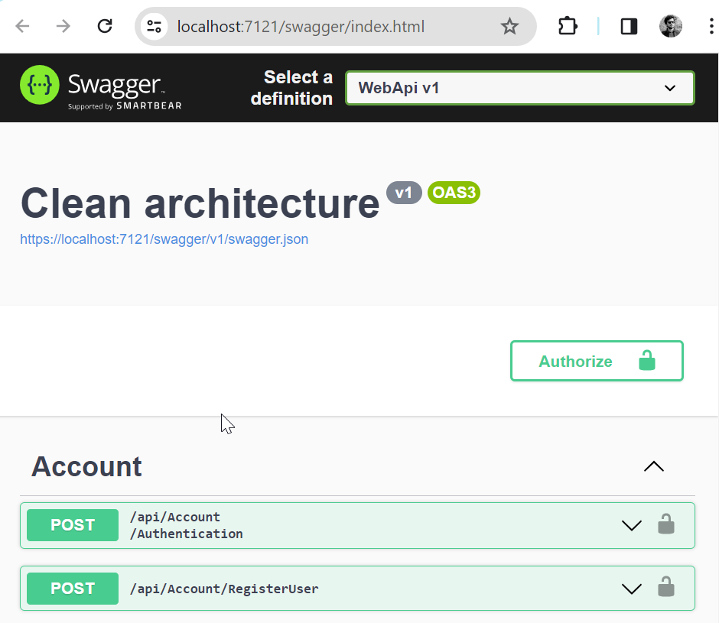
Jwt Authentication in .NET Core Clean Architecture
- What is Jwt: This is one of the most commonly used techniques to secure APIs, allowing users to access resources they are authorized to.
Structure of JSON Web Token:
1- Header: Usually contains the details on type of Token (JWT) and the algorithm used to sign the token, such as RSA, SHA256.
2- Payload: This is the most important section of the JWT. It contains the claims, which is technically the data we are trying to secure. Claims are details about the user, expiration time of the token, etc
3 Signature: It is an encryption between the header, payload and a secret key.
URL: https://jwt.io/
- Before implement Jwt you need to install these packages:
Install-Package Microsoft.AspNetCore.Authentication.JwtBearer
In this video we will implement:
1 - create user login
2 - setting jwt in appsetting.json
2 - generate Jwt token
3 - configuration of authentication scheme and validate Jwt token
4 - swagger configuration for authorize bearer token
5 – Test authentication with different roles using Postman

Slide 13
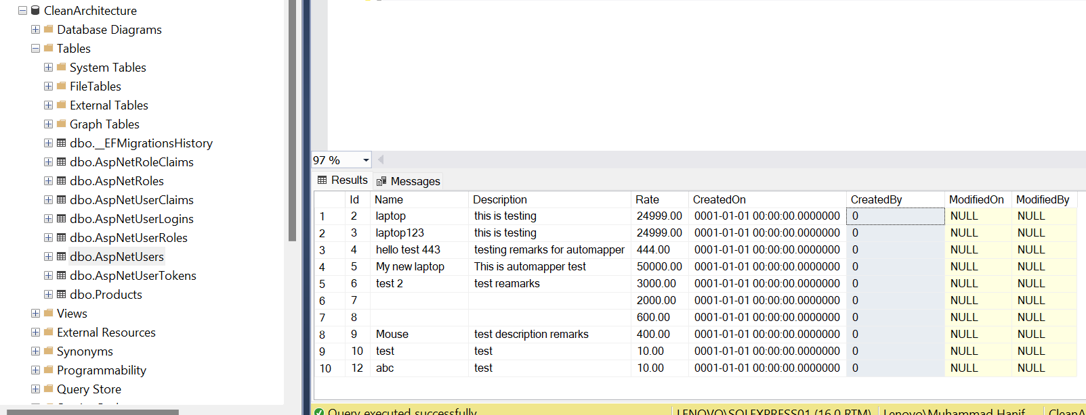
Authenticated UserId in .NET Core Clean Architecture
Logging: Logging activities and events related to a specific user helps in auditing and debugging. By associating actions with specific users, you can trace back any issues or security breaches to the responsible party.

Slide 14
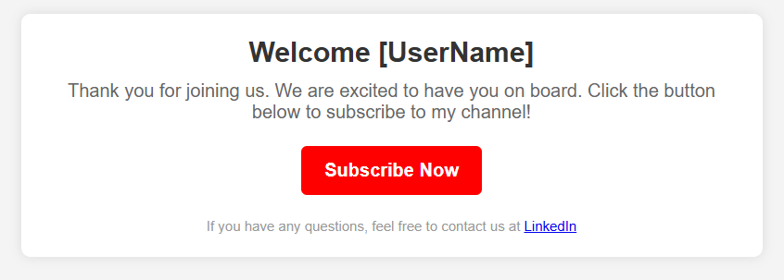
Send Email for Free using Gmail SMTP in .NET Clean Architecture with dynamic User Name

Slide 15
How to send Text & HTML Template Email in .NET Clean Architecture
There are several ways to send emails in .NET applications, such as using SendGrid, AWS SES, or SMTP Relay. However, in this tutorial, we will use MailKit. Install-Package MailKit
What’s an SMTP Server?
SMTP stand for (Simple Mail Transfer Protocol) server is a mail server responsible for sending, receiving, and relaying email messages between senders and recipients. It acts as a digital postman, ensuring that your emails reach the correct destination, and we will use Gmail's SMTP server to send emails.
Gmail allows you to send 500 emails per day using the Gmail SMTP Server for FREE.
Here is what you will need to use Gmail SMTP.
Gmail ID (Do not use a personal Email ID, quite risky if compromised.)
Gmail Password.
Host or SMTP Server address - If you are going with Gmail, use smtp.gmail.com
Port - Use 465 (SSL) or 587 (TLS)
After you get the details, You need to create AppPassword for specific app, https://myaccount.google.com/apppasswords

Slide 16
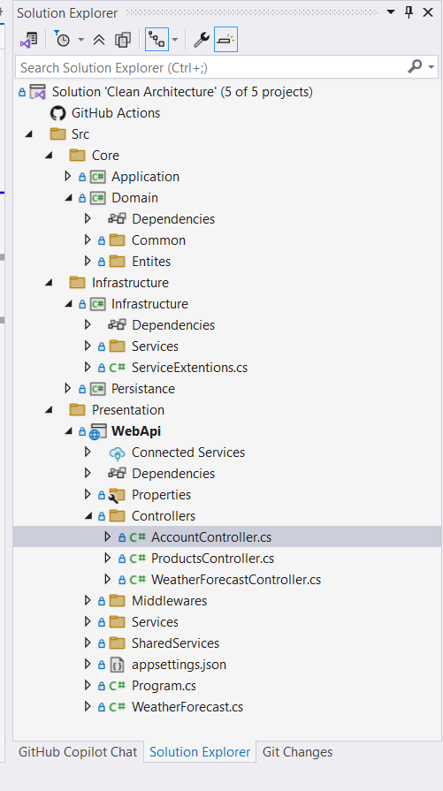
Email Confirmation in .Net Core Clean Architecture Part 13
Why Do We Confirm Emails?
Verify Ownership of the Email.
To make sure the person signing up actually owns the email they entered.
Prevents people from signing up with someone else's email.
Password resets, notifications etc.
Example Email Confirmation Link:
https://localhost:5001/account/confirm-email?userId=ab12345c-678d-9ef0-gh12-ijk345lmn678&code=VGVzdENvbmZpcm1hdGlvblRva2Vu

Slide 17
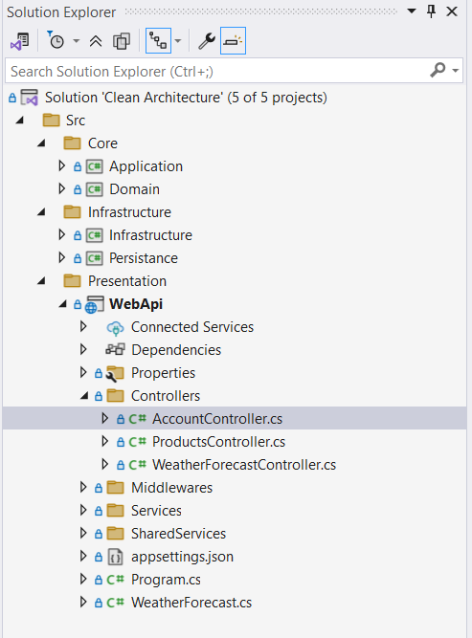
Resend Email Confirmation in .Net Core Clean Architecture Part 14

Slide 18
Forgot password using Identity in .Net Core Clean Architecture Part 15

Slide 19
